Slide 1

TIC PROJECT
By Group 4 :
Bouhadi Maroua
Latoui Khadidja
Guendouz Israa
Benacer Nada
SIGL 2025-2026
Final project in TIC

Slide 2
TIC PROJECT
By Group 4 :
Bouhadi Maroua
Latoui Khadidja
Guendouz Israa
Benacer Nada
SIGL 2025-2026
Final project in TIC

Slide 3




TIC PROJECT plan
conclusion
By Group 4 :
Bouhadi Maroua
Latoui Khadidja
Guendouz Israa
Benacer Nada
SIGL 2025-2026
Final project in TIC

Slide 4


introduction
Definition
ICT refers to all technologies used to create, process, store, transmit, and retrieve digital information. It combines computing tools and telecommunications systems to improve access to information and enable effective communication across various fields such as education, business, and healthcare.

Slide 5
TIC or ICT (Information and Communication Technologies) refers to all technologies used to create, process, store, transmit, and retrieve digital information. It combines computing tools and telecommunications systems to improve access to information and enable effective communication across various fields such as education, business, and healthcare.
Definition

Slide 6
Definition
Enable fast and easy communication worldwide
Provide quick access to information and knowledge
Improve education through e-learning and digital tools
Increase productivity and efficiency in businesses
Support healthcare (telemedicine, digital records)
Why are TIC important today?

Slide 7


Components of TIC

Slide 8
Components of TIC
Hardware
The components of ICT include hardware (computers, mobile devices), software (applications and systems), networks, data management (databases, cloud storage), telecommunications, IoT, and people and procedures. Together, they enable efficient communication, information management, and digital innovation.
software
Network and internet
Components of TIC

Slide 9
Components of TIC
Hardware
software
Hardware is the physical foundation of ICT, consisting of the devices and equipment used to perform tasks, process data, and connect networks . ere are the main categories of hardware in ICT: Computers , Mobile Devices, Networking Equipment, Peripheral Devices
Network and internet
Components of TIC

Slide 10
Components of TIC
software
Hardware
Software consists of programs and applications that run on hardware, allowing users to perform tasks, manage data, and communicate. It can be categorized into different types : Operating Systems (OS) , Application Software, Utility Software, Development Software
Network and internet
Components of TIC

Slide 11
Network and internet
Components of TIC
Hardware
ICT components enable digital communication, data management, and connectivity. Networks (Internet, LAN, WAN, intranets/extranets) connect devices and support information exchange. Data management systems (databases, data warehouses, cloud storage, big data) organize and analyze information. Telecommunications and IoT connect people and smart devices for real-time communication and automation. People (users, IT professionals, support staff) operate and maintain ICT systems. Procedures and policies ensure security, reliability, and ethical use of technology. Together, these components form the backbone of modern digital infrastructure.
software
Components of TIC

Slide 12
Technologies related to TIC
01
Definition
Types of Google Services
ICT refers to all technologies used to create, process, store, transmit, and retrieve digital information. It combines computing tools and telecommunications systems to improve access to information and enable effective communication across various fields such as education, business, and healthcare.

Slide 13
01
Types of Google Services

Slide 14
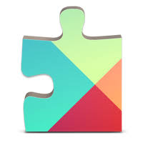
Google Services
01
Google Services refers to the comprehensive and integrated suite of applications, platforms, and products developed and provided by Google (Google LLC and its affiliates).

Slide 15
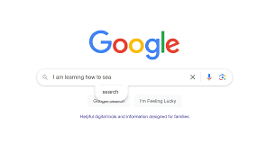
Google Search:
The primary web search engine
01

Slide 16
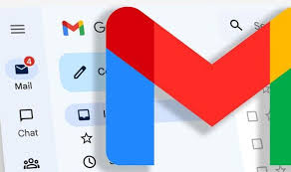
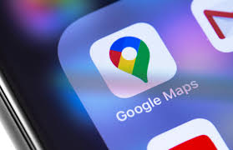
Google Search:
The primary web search engine
Gmail: Email service
Google Maps/Earth: Mapping, navigation, and location services.
01

Slide 17

Google Search:
The primary web search engine
Gmail: Email service
YouTube: Video hosting and sharing platform
Google Maps/Earth: Mapping, navigation, and location services.
01

Slide 18
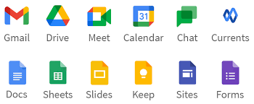
Google Search:
The primary web search engine
YouTube: Video hosting and sharing platform
Google Docs, Sheets, Slides: Online word processing, spreadsheets, and presentation tools.
Google Drive: Cloud storage and file synchronization.
Google Calendar: Scheduling and time management.
Google Meet: Video conferencing.
Gmail: Email service
Google Maps/Earth: Mapping, navigation, and location services.
01

Slide 19
03
Microsoft Tools
02
01

Slide 20
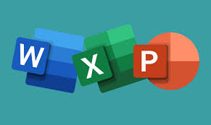
Microsoft Tools
Word, Excel, and PowerPoint
Word, Excel, and PowerPoint
are core Microsoft Office apps: Word is for creating text-based documents (letters, reports); Excel manages data in grids, performing calculations with spreadsheets and formulas; and PowerPoint designs visual slide shows for presentations, incorporating text, images, and multimedia.
02
01

Slide 21
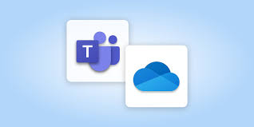
Microsoft Tools
Microsoft Teams OneDrive
Microsoft Teams is a collaboration hub for chatting, meetings, and teamwork
OneDrive is personal cloud storage for individual files, syncing across devices.
02
01

Slide 22

Git & GitHub
03
Definiton
Git is a free, open-source version control tool that developers install locally on their personal computers, while GitHub is a pay-for-use online service built to run Git in the cloud.
02
01

Slide 23


The Importance of GitHub in Modern Development
03
Streamlined Version Control
Enhanced Collaboration
Promoting Transparency and Documentation
Building and Nurturing Communities
Integrating with Modern Development Tools
Security and Code Quality
02
01

Slide 24
Conclusion
Streamlined Version Control
Enhanced Collaboration
Promoting Transparency and Documentation
Building and Nurturing Communities
Integrating with Modern Development Tools
Security and Code Quality
Information and Communication Technologies (ICT) have become a fundamental part of modern society. They enable fast communication, efficient information management, and global connectivity across different sectors such as education, business, healthcare, and administration. Through tools and services like Microsoft applications, cloud computing, networks, and collaborative platforms, ICT improves productivity, supports innovation, and simplifies complex tasks.
Despite challenges such as security risks and technological dependence, the benefits of ICT largely outweigh the drawbacks. Mastering ICT skills is essential for academic success and professional development, as these technologies continue to shape the future of work and digital transformation worldwide.

